Slide 1


Mastering Data Pipelines
Building Scalable, Reliable, and Efficient Data Workflows
Oluwagbemiga Adegboyega

Slide 2
Agenda
01
02
03
Defining Data Pipelines
Importance of Data Pipelines and why Master them
Key Components Of Data Pipelines
04
05
06
Architectural Patterns
Principles for Designing Data Pipelines
Best Practices For Data Pipelines
07
08
09
Modern Tech Stack
Common Pitfalls
Key Takeaways

Slide 3



Defining Data Pipelines
A series of processes to extract, transform, and load (ETL/ELT) data. Moves data from sources to destinations for analytics, ML, or storage.
Automated processes for moving and transforming data through its lifecycle (Generation, Storage, Ingestion, Transformation, Serving) to enable analytics, ML, and business decisions
A data pipeline automates the flow of data from sources to destinations.
Purpose: Ensures data is collected, transformed, and delivered reliably.
Source
Transform
Destination
Data origin
Processing and cleaning
Storage or use
Examples: Collecting sales data from an e-commerce site, cleaning it, and loading it into a data warehouse.
Real-time dashboards, data warehousing, ML model training.

Slide 4
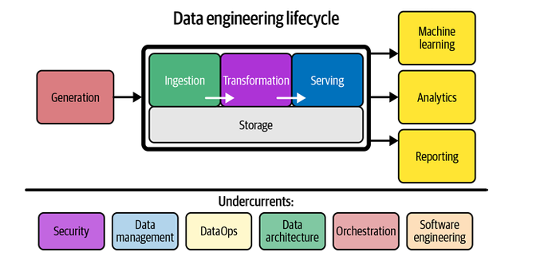
The Data Engineering Lifecycle Overview
Reference: Fundamentals of Data Engineering by Joe Reis & Matt Housley

Slide 5
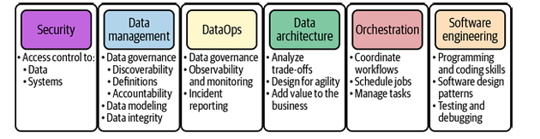
Undercurrents

Slide 6
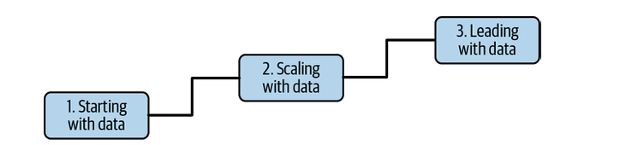
Data Maturity Stages

Slide 7
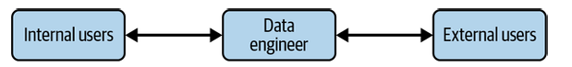
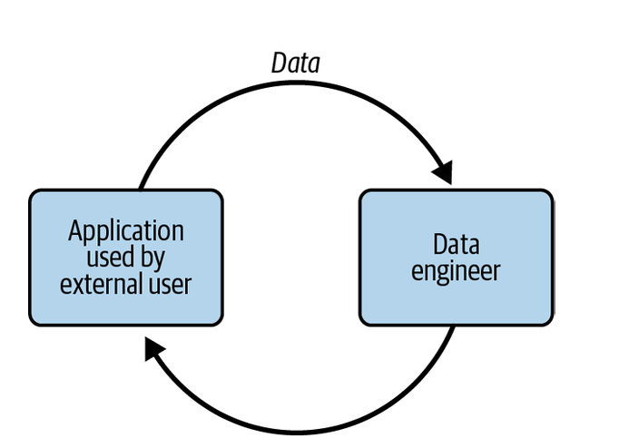
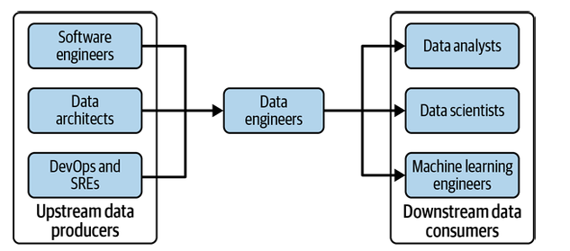
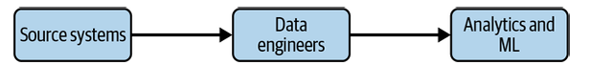
Data Engineers in Organizations
A
B
D
C

Slide 8


Why Data Pipelines Matter: Fueling Modern Decisions
Powering Insights
Driving Value
Avoiding Pitfalls
Data pipelines are the backbone of modern analytics, machine learning, and business intelligence. They transform raw data into actionable insights.
Over 90% of the value from big data initiatives stems from well-designed, efficient batch pipelines. (Lars Albertsson)
Poorly constructed pipelines lead to costly delays, data quality issues, and significant loss of critical business insights.

Slide 9
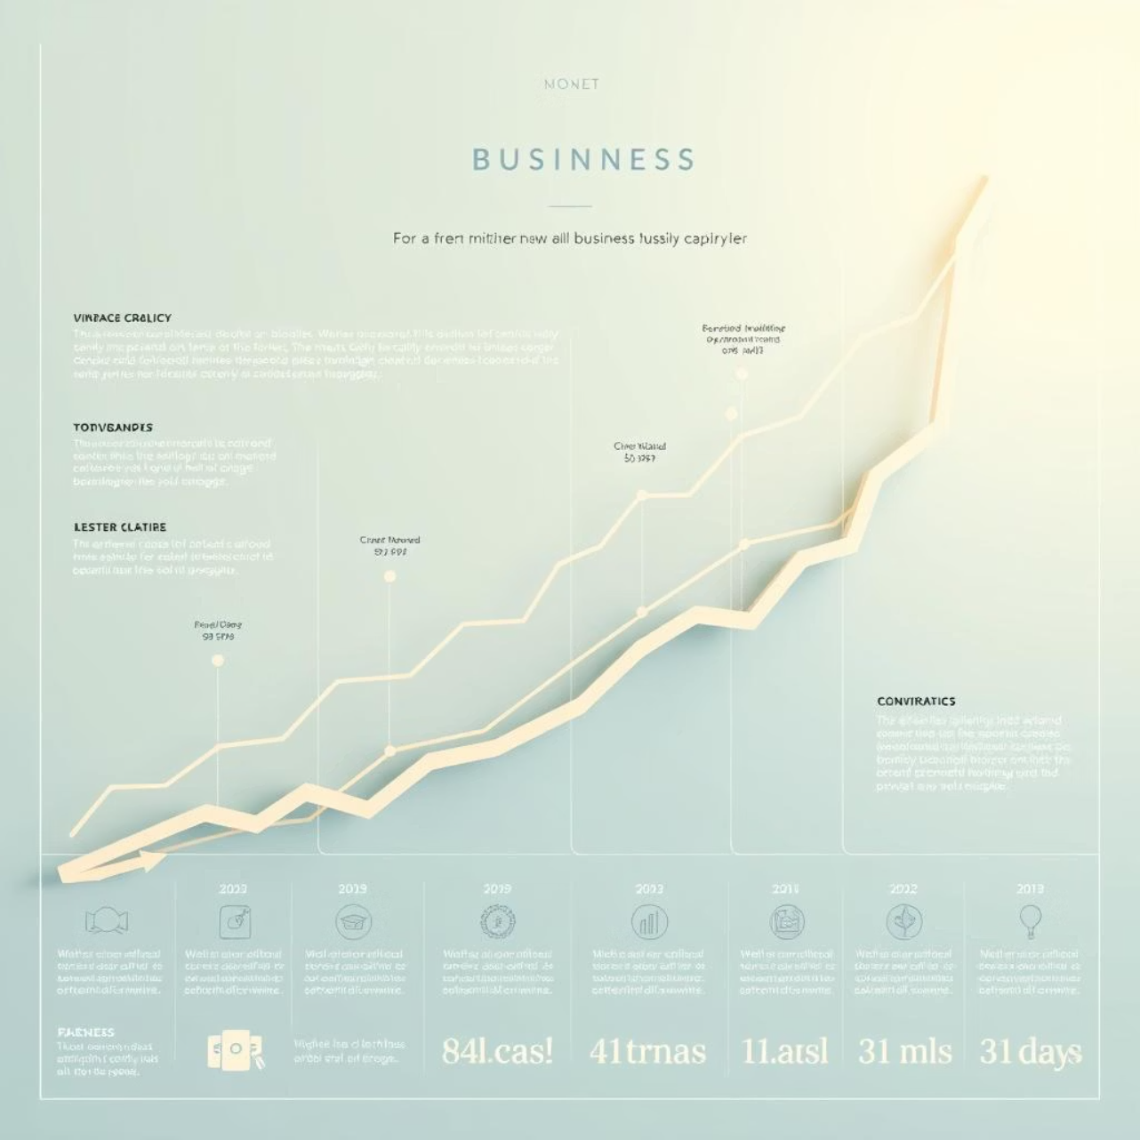
Importance of Data Pipelines
Enable scalable data processing
Ensure data quality and consistency
Support real-time and batch analytics
Connect disparate systems (databases, APIs, cloud)

Slide 10



Why Master Data Pipelines?
Data pipelines are the backbone of reliable, scalable data-driven decision-making. Understanding them is crucial for any organization aiming to leverage its data effectively.
Reliable Data Foundation
Prevent Data Issues
Unlock Insights
Pipelines ensure data integrity and accessibility.
Poor design leads to quality issues and downtime.
Mastery drives efficient flow from raw data to actionable insights.

Slide 11
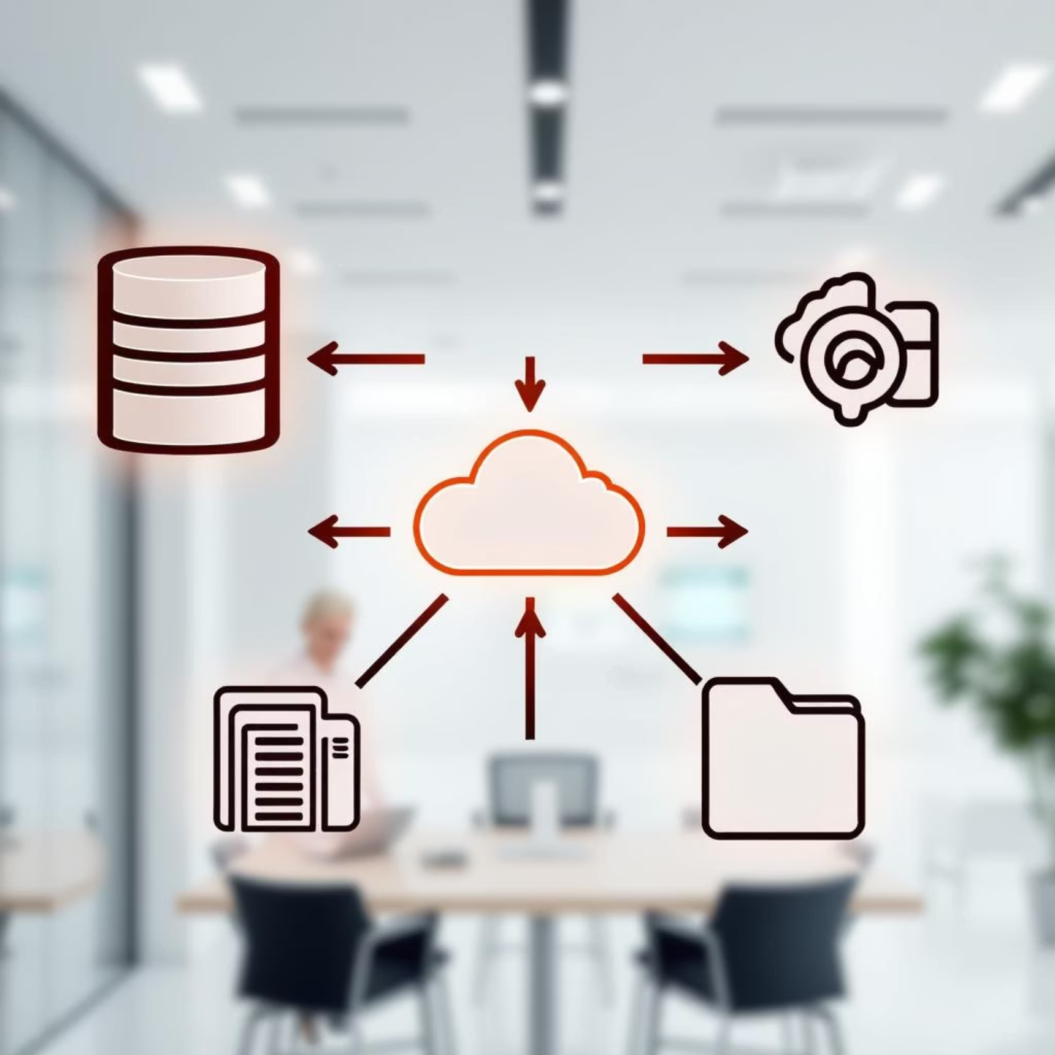
Why Master Them?
Handles big data's 3Vs (volume, variety, velocity).
Reduces errors.
Supports real-time insights.
They are the backbone for robust data systems.

Slide 12









Key Components of a Data Pipeline
Ingestion
Sources
Responsible for collecting and importing data (e.g., Apache Kafka, AWS Kinesis). Batch or streaming
Databases, APIs, logs, IoT sensors, social media feeds.
Transformation
Cleaning, enrichment, aggregation (e.g., Apache Spark, Flink).
Monitoring
Detects errors, latency, and data quality issues. Ensures pipeline health.
Storage
Centralized repositories like data lakes (S3, HDFS) or data warehouses (Snowflake, Redshift),
databases
Orchestration
Coordinates tasks (e.g., Airflow, Luigi). Workflow management and scheduling

Slide 13

Architectural Patterns
Common Pipeline Architectures
Batch Pipelines
1
Ideal for large volumes of data processed periodically. Reliable, simpler to manage, and cost-effective for historical analysis.
Tools: Hadoop, Apache Spark
Streaming Pipelines
2
Designed for real-time data processing, enabling immediate insights and responses. Requires complex state management.
Tools: Kafka Streams, Apache Flink
Lambda Architecture
3
A hybrid approach combining batch and streaming layers to balance real-time needs with historical accuracy.
Benefit: Offers robust, fault-tolerant data serving.

Slide 14
Data Pipeline Architecture
Batch (Executes jobs on a schedule, suitable for large datasets processed periodically)
vs.
Streaming (Processes data in near real-time) pipelines.
ETL (Extract, Transform, Load) (process data before storage)
vs.
ELT (Extract, Load, Transform) (store raw data, then process).
Cloud-native vs. on-premises solutions.

Slide 15
Batch Vs Streaming
Feature
Batch
Streaming
Processing
Periodic
Real-time
Latency
High
Low
Complexity
Moderate
High
Use Cases
Reports, ETL
Monitoring, IoT
Hybrid pipelines combine both for flexibility.

Slide 16

Principles for Designing Scalable Pipelines
Modularity: Reusable, independent components.
Scalability: Handle growing data volumes.
Fault Tolerance: Retries, error handling.
Monitoring: Track performance and data quality.

Slide 17

Understanding Your Data Domain
Before writing a single line of code, immerse yourself in the business context. This means understanding:
Business/Domain-specific terminology: Speak the language of the business. What do "CAC," "churn," or "inventory turnover" really mean in this context? (e.g., "customer lifetime value" in e-commerce, "patient journey" in healthcare)
Critical/Key metrics: What numbers drive decisions? Revenue, user engagement, sensor readings?
(e.g., daily active users, transaction volume, sensor readings)
Data relationships: Identify primary and foreign keys to understand how datasets connect and interact. This prevents extracting irrelevant data, optimizing pipeline efficiency.
Why it matters: This foundational step ensures your pipeline delivers truly valuable insights, not just raw data.

Slide 18
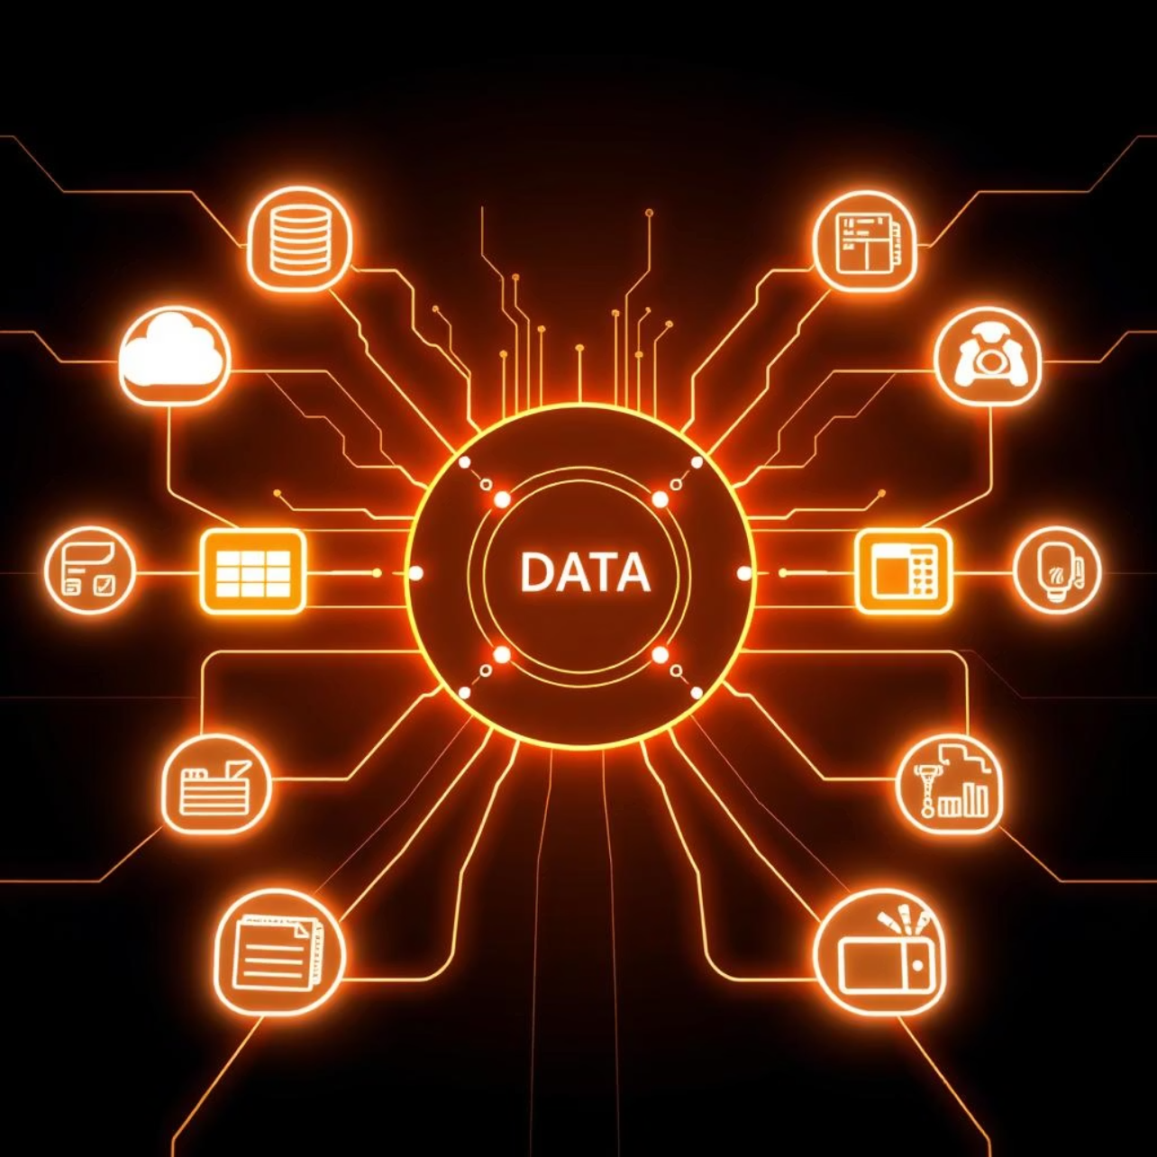
Understanding Data Sources
The origin of your data dictates much of your pipeline's design. Consider:
Source Type: Is it a transactional database (MySQL), streaming IoT sensors, or a REST API from a web application?
Data Volume & Velocity: Is it batch or real-time? How much data is generated per second/minute/day?
Core Capabilities: Does the source support replication, change data capture (CDC), or specific query patterns?
Understanding these characteristics is crucial for selecting the appropriate ingestion and computation engines.

Slide 19
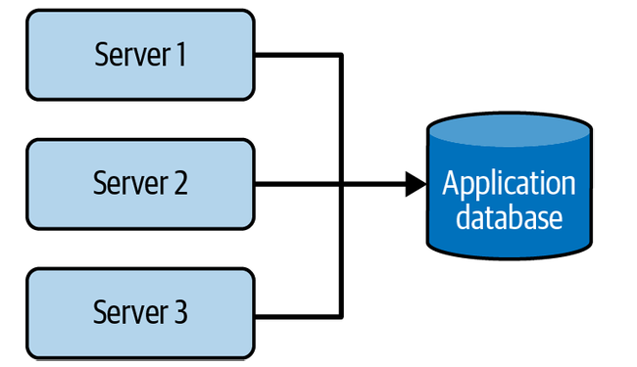
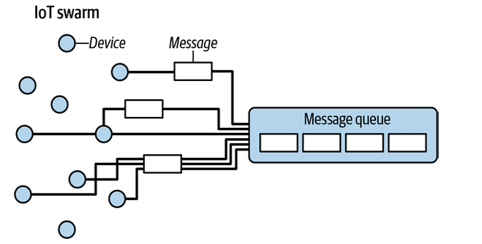
Generation/Source Systems
Key Concepts
Data originates from files, databases, APIs, IoT, logs, streams.
Consider schema (fixed vs. schemaless) and time types (event, ingestion, processing)
Challenges
Duplicates, late arrivals, schema changes, upstream dependencies
Best Practice: Build upstream relationships for data quality.

Slide 20
Best Practices for Source Systems
Understand Data
Choose Robust Formats
Build Relationships
Persistence, errors, schema evolution; communicate with owners.
Prefer Parquet, Avro over CSV; use managed connectors.
Collaborate with upstream teams for data quality.

Slide 21
Key Considerations for the ingestion Phase
What are the use cases for the data I’m ingesting? Can I reuse this data rather than create multiple versions of the same dataset?
Are the systems generating and ingesting this data reliably, and is the data available when I need it?
What is the data destination after ingestion?
How frequently will I need to access the data?
In what volume will the data typically arrive?
What format is the data in? Can my downstream storage and transformation systems handle this format?
Is the source data in good shape for immediate downstream use? If so, for how long, and what may cause it to be unusable?
If the data is from a streaming source, does it need to be transformed before reaching its destination? Would an in-flight transformation be appropriate, where the data is transformed within the stream itself?

Slide 22
Key Considerations for the batch versus stream ingestion
If I ingest the data in real time, can downstream storage systems handle the rate of data flow?
Do I need millisecond real-time data ingestion? Or would a micro batch approach work, accumulating and ingesting data, say, every minute?
What are my use cases for streaming ingestion? What specific benefits do I realize by implementing streaming? If I get data in real time, what actions can I take on that data that would be an improvement upon batch?
Will my streaming-first approach cost more in terms of time, money, maintenance, downtime, and opportunity cost than simply doing batch?
Are my streaming pipeline and system reliable and redundant if infrastructure fails? What tools are most appropriate for the use case? Should I use a managed service (Amazon Kinesis, Google Cloud Pub/Sub, Google Cloud Dataflow) or stand up my own instances of Kafka, Flink, Spark, Pulsar, etc.? If I do the latter, who will manage it?
What are the costs and trade-offs? If I’m deploying an ML model, what benefits do I have with online predictions and possibly continuous training?
Am I getting data from a live production instance? If so, what’s the impact of my ingestion process on this source system?

Slide 23
Data Ingestion Strategies
Once sources are identified, the next step is to strategize how to ingest the data efficiently.
Incremental Load
Full Load
Upsert Load
Pulls only new or changed data based on timestamps or specific identifiers. Ideal for frequent updates and reducing load.
Replaces the entire target table with fresh data. Simpler to implement but resource-intensive for large datasets.
Combines update and insert operations based on primary keys. Perfect for maintaining historical data while ensuring current accuracy.
Example: Loading new transactions every 15 minutes.
Example: Daily refresh of a small reference table.
Example: Updating customer profiles or inserting new ones.
Best Practice: Validate data at ingestion.

Slide 24
Data Transformation
Transforming Data
Cleaning: Remove duplicates, handle missing values.
Enrichment: Join with external data.
Aggregation: Summarize for analytics.
Tools: Apache Spark, dbt, Python.

Slide 25
Key Considerations for the Transformation Phase
What’s the cost and return on investment (ROI) of the transformation? What is the associated business value?
Is the transformation as simple and self-isolated as possible?
What business rules do the transformations support?
Am I minimizing data movement between the transformation and the storage system during transformation?

Slide 26
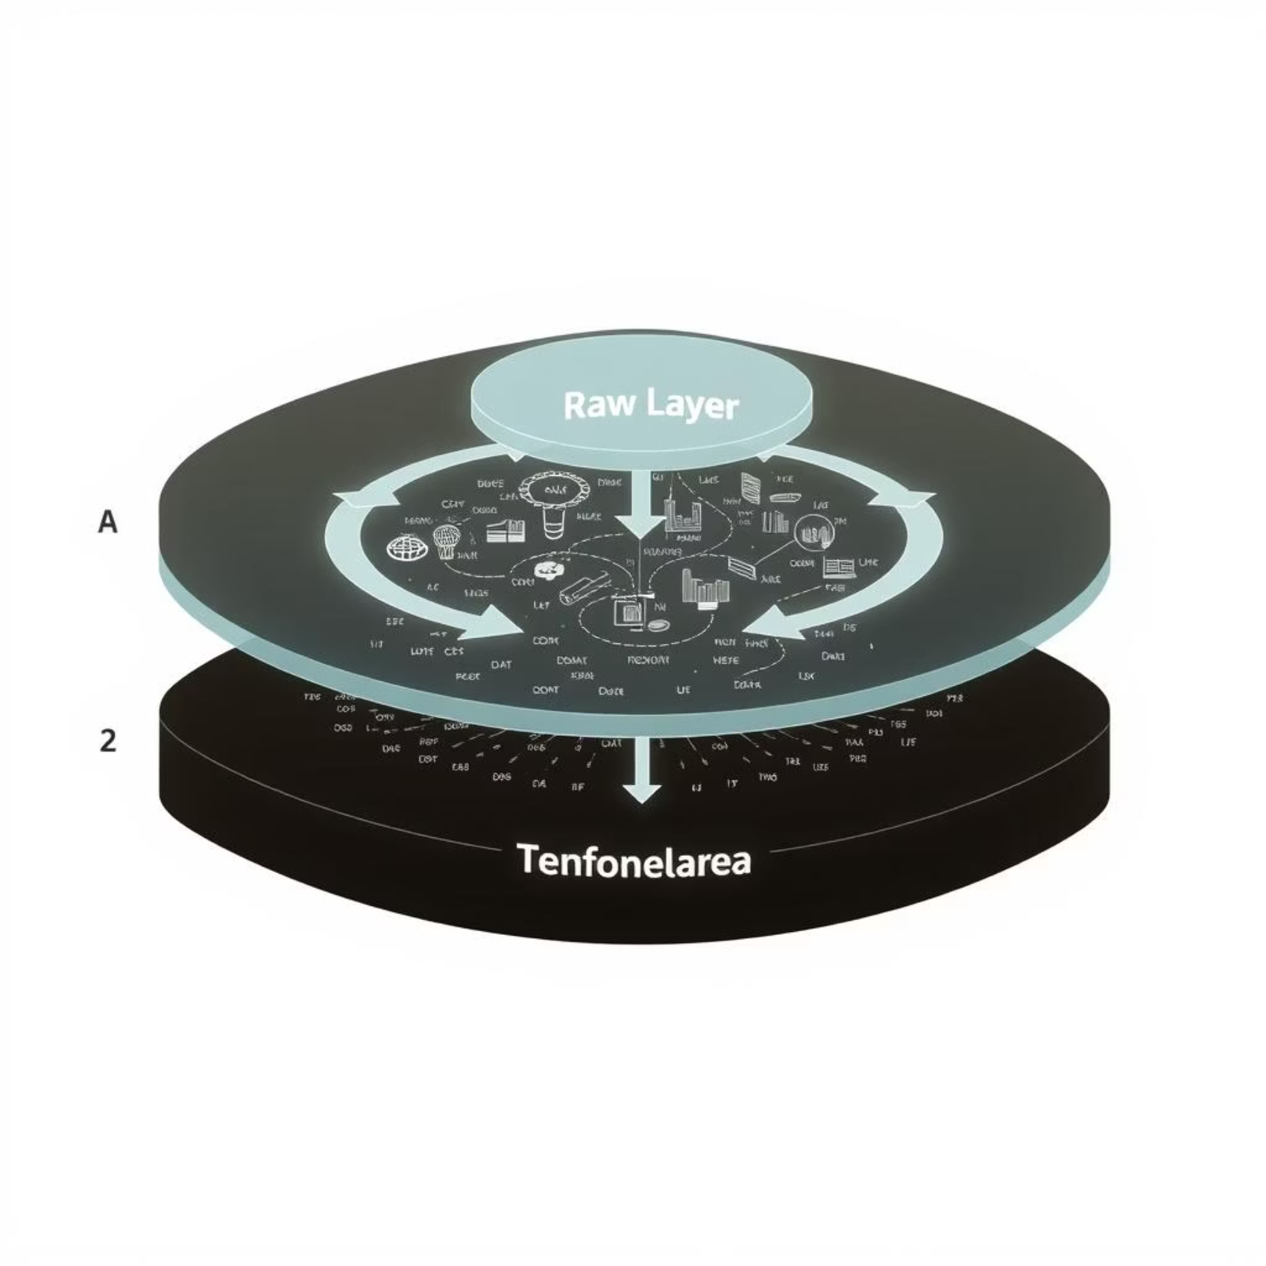
The 3-Layers of Data in Data Pipeline Architecture
Raw Layer
Immutable, source-aligned data with minimal transformation.
Transformed Layer
Cleaned, modeled data using dimensional or Data Vault modeling.
Consumption Layer
Business-ready datasets optimized for analytics and reporting.

Slide 27






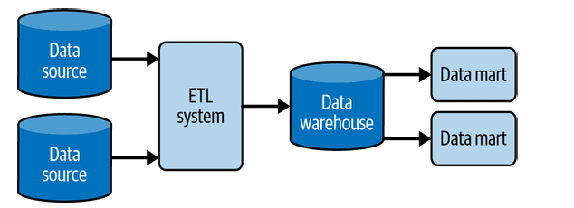
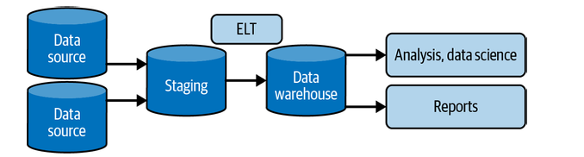
Data Storage Selection
The right storage solution depends entirely on your data's use case and query patterns. Where your data lives impacts how it's accessed and analyzed. Consider your use case:
Data Lakes
Databases (Relational & NoSQL)
Data Warehouses
Amazon S3, HDFS. For raw, untransformed data. Highly flexible for future use cases.
Cassandra, MongoDB. Ideal for frequent ad-hoc queries and handling large volumes of unstructured data. Relational (PostgreSQL etc.)
AWS Redshift, Apache Hive. For transformed, structured data optimized for analytical queries and reporting.

Slide 28
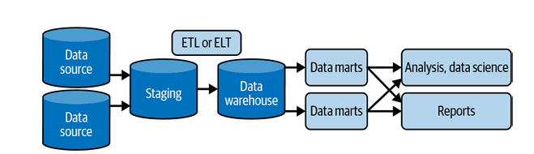
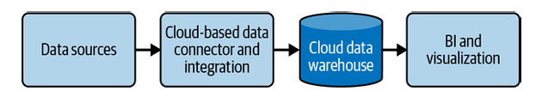
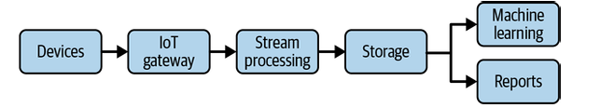
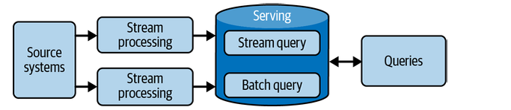
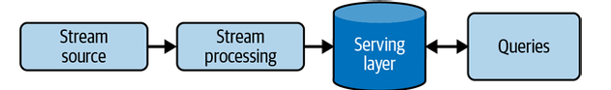
Data Storage Selection

Slide 29
Storage Considerations
Considerations: Cost, scalability, query performance.
Storage Type
Pros
Cons
File/Object Storage
Scalable, cost-effective for large volumes
Eventual consistency, less structured
Block Storage
High performance, low latency
Less scalable, higher cost
Data Lake/Warehouse
Centralized, flexible, analytics-ready
Complexity, governance needs

Slide 30
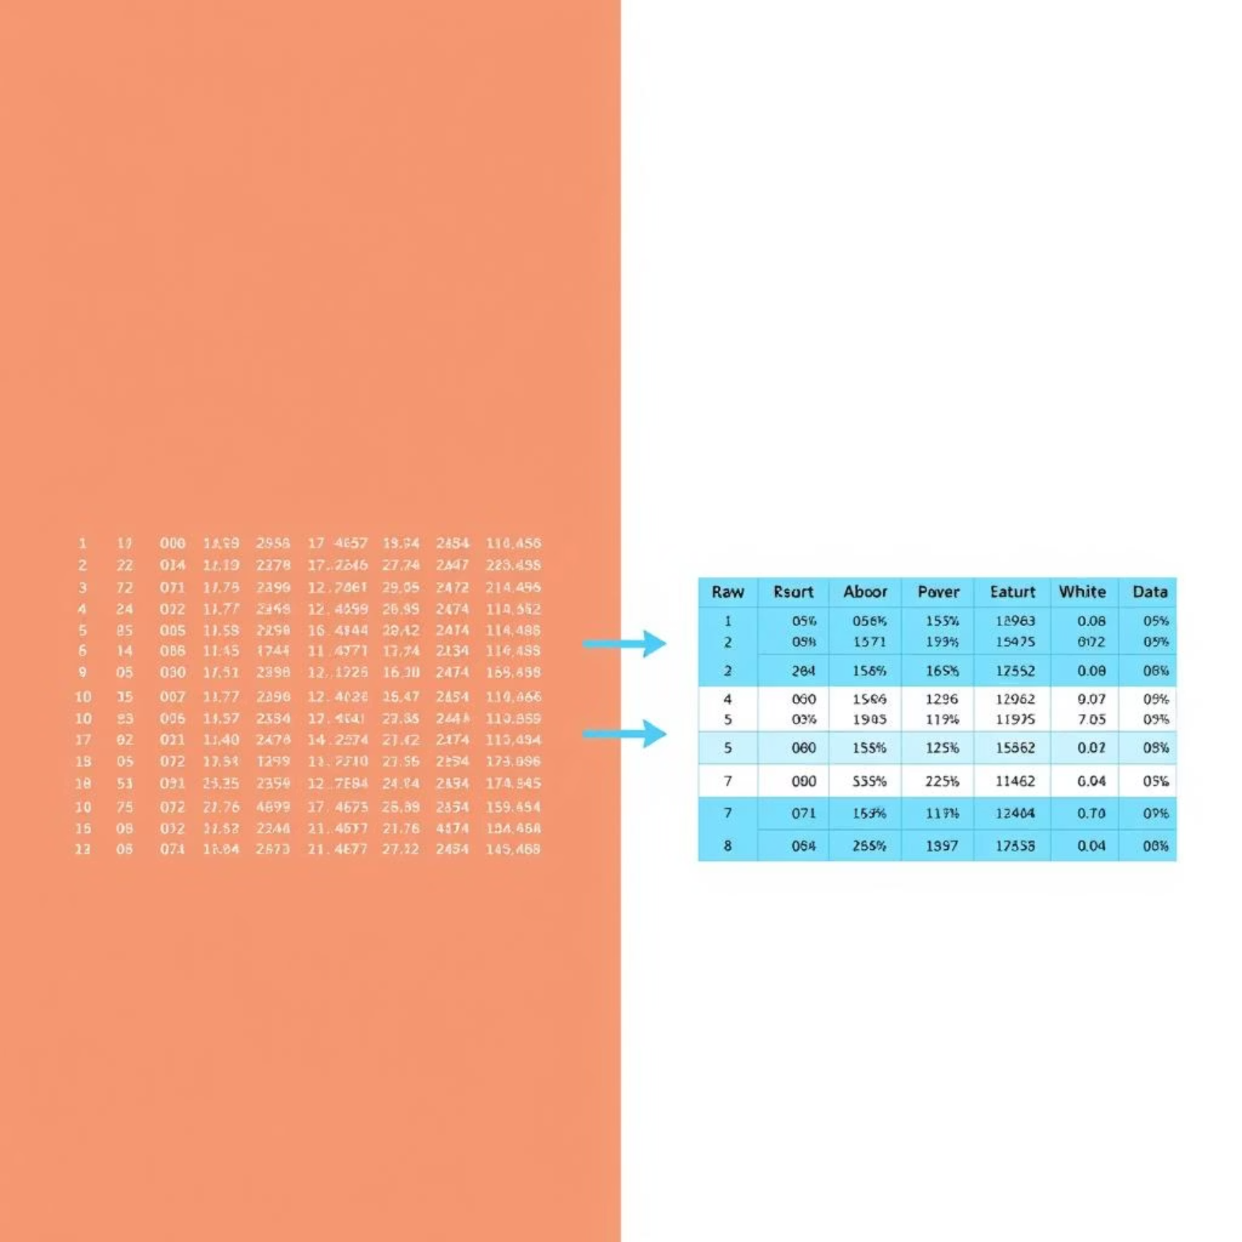
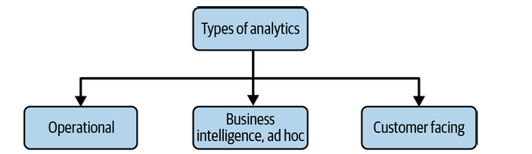
Serving Data
For analytics (BI, operational), ML, reverse ETL (feedback to sources).
Focus on discoverability and quality.
Best Practice: Build analytics before ML.

Slide 31
Orchestration
Workflow Orchestration
Tools: Apache Airflow, Prefect, Dagster
Features: Scheduling, dependency management, retries, notify on failures
Best Practice: Use Directed Acyclic Graphs (DAGs).

Slide 32
Pipeline Monitoring and Governance
Reliability is paramount, especially for high-stakes applications like financial fraud detection.
99.9%
0%
<5min
Uptime
Data Loss
Incident Response
Monitor availability and performance to ensure continuous data flow.
Implement checks to prevent data corruption or incomplete transfers.
Fast alerts and recovery from failures to minimize impact.
Tools like Grafana, Datadog, and PagerDuty provide real-time insights, log errors, and automate alerts, maintaining data integrity and customer trust.

Slide 33
Best Practices for Data Pipelines
Designing pipelines with best practices in mind ensures reliability, maintainability, and data quality.
Data Quality Checks: Implement validation and deduplication early and continuously.
Idempotent Design: Build pipelines to avoid duplicate data and ensure safe retries.
Separate Logic: Decouple transformation logic from I/O operations for better maintainability.
Metadata & Logging: Track pipeline runs and simplify debugging with comprehensive logs.
Version Control: Manage code changes effectively using tools like Git.
Design for modularity, scalability and fault-tolerance
Document pipeline architecture, flows and dependencies.
Data Linage: Track every transformation step from source to consumption, ensuring auditability and simplifying debugging.
Note:
Proactive quality checks build trust in your data and prevent downstream issues.

Slide 34

Handling Real-World Challenges
Scalability: Use containerization (Docker) and IaC (Terraform) for reproducible environments.
Fault Tolerance: Build retry mechanisms and alerting for pipeline failures.
Security: Encrypt data in transit and at rest; enforce role-based access controls.
Data Freshness: Balance batch vs. streaming approaches based on business needs.

Slide 35

The Modern Stack
Tools & Technologies Overview (2025)
Ingestion
Apache Kafka, AWS Kinesis, Google Pub/Sub for scalable real-time data streaming.
Processing
Apache Spark, Flink, Beam for distributed data processing; dbt for SQL-based transformations.
Storage
Data Lakes (S3, GCS) for raw data; Data Warehouses (Snowflake, BigQuery) for structured analytical data.
Orchestration
Apache Airflow, Prefect, Dagster for scheduling, monitoring, and managing complex workflows.

Slide 36

Common Missteps
Pitfalls & How to Avoid Them
Over-Engineering Streaming
Ignoring Data Quality
Poor Documentation & Lineage
Neglecting data quality until production failures occur is a costly mistake. Implement checks early and often.
Don't opt for complex streaming solutions when simpler batch processing would suffice. Focus on actual business value.
A lack of documentation and clear data lineage turns troubleshooting into a nightmare. Prioritize clarity for long-term health.

Slide 37
Common Challenges
Data quality issues: Missing, ,inconsistent, duplicate data or Inconsistent formats.
Pipeline failures and downtime.
Scalability: Handling growing data volumes efficiently.
Schema Challenges: Handling schema changes.
Managing cost and resource usage: Avoiding unnecessary cloud resource expenses..
Security and compliance concerns: Protecting sensitive data.
Latency: Balancing speed vs. accuracy

Slide 38
Solution to Common Challenges
Data Quality: Schema validation, testing
Scalability: Auto-scaling cloud resources
Latency: Optimize transformations, use streaming
Cost: Monitor usage, leverage serverless

Slide 39
The Future of Data Pipelines
Serverless: AWS Lambda, Google Cloud Functions
Real-Time Analytics: Streaming pipelines
AI-Driven Optimization: Auto-tuning pipelines
DataOps: Collaboration and automation

Slide 40
Key Takeaways
Domain Driven Design
Strategic Choices
Always start by deeply understanding the business context and data needs. Business First!
Every choice, from source to storage, impacts pipeline performance.
Critical for Data-Driven Organizations
Design for Scalability and Reliability
Pipelines are the backbone of modern data strategies.
Build robust systems that can grow and withstand failures.
Choose Tools Based on Use Case
Automate and Monitor for Long-Term Success
Select the right technologies for your specific needs.
Workflow managers and monitoring tools are essential for
reliability.

Slide 41
Your Journey as a Data Engineer
Designing data pipelines is an iterative process requiring a blend of business acumen, technical expertise, and an eye for continuous improvement.
Next Steps
Explore open-source tools: Experiment with Airflow, Spark, and Kafka.
Contributions: Engage with the data engineering community.
Build: Start with a simple project and iterate.
Stay Current: Follow industry trends, pursue certifications, and engage with the community.
"Data engineering is not just about moving data; it's about building the circulatory system of modern organizations."

Slide 42
Thank You

